Slide 1
Propositional Logic

Slide 2
What is Proposition?
A statement that is either true or false
2 + 3 = 5

Slide 3
What is Proposition?
A statement that is either true or false
2 + 3 = 5 : true

Slide 4
What is Proposition?
A statement that is either true or false
1 + 1 = 3

Slide 5
What is Proposition?
A statement that is either true or false
1 + 1 = 3 : false

Slide 6
What is Proposition?
A statement that is either true or false
Dhaka is the capital of Bangladesh

Slide 7
What is Proposition?
A statement that is either true or false
Dhaka is the capital of Bangladesh : true

Slide 8
What is Proposition?
A statement that is either true or false
Chittagong is the capital of Bangladesh : false

Slide 9
What is Proposition?
A statement that is either true or false
Give me an A

Slide 10
What is Proposition?
A statement that is either true or false
Give me an A
Neither true or false
Not a proposition

Slide 11
What is Proposition?
A statement that is either true or false
Would there be a third world war?
Neither true or false
Not a proposition

Slide 12
Compound Proposition
All humans are mortal and 2 + 3 =5

Slide 13
Compound Proposition
All humans are mortal and 2 + 3 =5 :
Hard to depict whether true / false

Slide 14
Compound Proposition
All humans are mortal and 2 + 3 =5

Slide 15
Compound Proposition
All humans are mortal : true and 2 + 3 =5 : true

Slide 16
Compound Proposition
All humans are mortal : true and 2 + 3 =5 : true
Logical connector

Slide 17
Propositional Variable
All humans are mortal

Slide 18
Propositional Variable
All humans are mortal: p
p can either be true / false

Slide 19
Propositional Variable
All humans are mortal and 2 + 3 =5
p and q

Slide 20
Logical Connector
Not
And
Or
Implies
Xor
Iff

Slide 21
Logical Connector: NOT
Notation: ¬
Truth table:
p | ¬ p
0 | 1
1 | 0

Slide 22
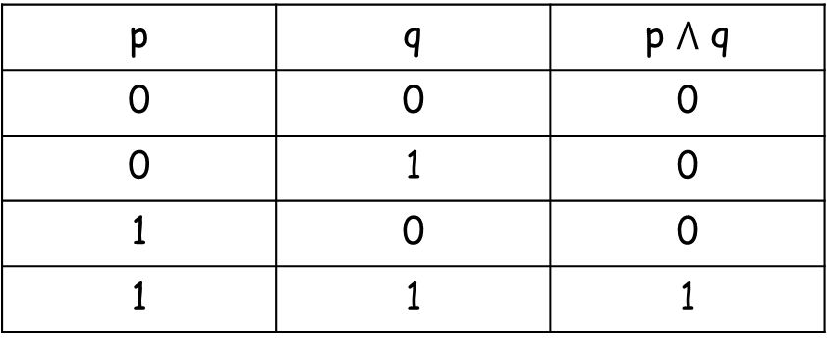

Logical Connector: AND
Notation: $⋀$
Truth table:
p | q | p $⋀$ q
0 | 0 | 0
0 | 1 | 0
1 | 0 | 0
1 | 1 | 1

Slide 23
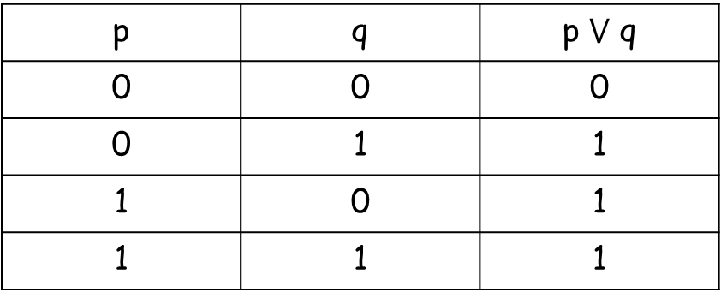

Logical Connector: OR
Notation: $⋁$
Truth table:
p | q | p $⋁$ q
0 | 0 | 0
0 | 1 | 1
1 | 0 | 1
1 | 1 | 1

Slide 24
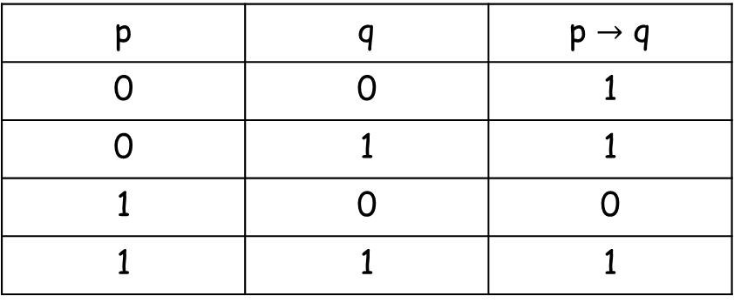

Logical Connector: IMPLIES
Notation: $→$
Truth table:
p | q | p $→$ q
0 | 0 | 1
0 | 1 | 1
1 | 0 | 0
1 | 1 | 1

Slide 25

Logical Connector: XOR
Notation: $⊕$
Truth table:
p | q | p xor q
0 | 0 | 0
0 | 1 | 1
1 | 0 | 1
1 | 1 | 0

Slide 26

Logical Connector: IFF
Notation: $↔$
Truth table:
p | q | p IFF q
0 | 0 | 1
0 | 1 | 0
1 | 0 | 0
1 | 1 | 1

Slide 27

FINDING TRUTH TABLE OF COMPOUND PROPOSTIONS: Example1
P $⋀$ q $⊕$ s
No of propositional variables = 3
No of rows in truth table = 2³ = 8

Slide 28

FINDING TRUTH TABLE OF COMPOUND PROPOSTIONS
P $⋀$ q $⊕$ s
p | q | s
0 | 0 | 0
0 | 0 | 1
0 | 1 | 0
0 | 1 | 1
1 | 0 | 0
1 | 0 | 1
1 | 1 | 0
1 | 1 | 1

Slide 29

FINDING TRUTH TABLE OF COMPOUND PROPOSTIONS
P $⋀$ q $⊕$ s
Which operation to perform first?
p $⋀$ q / q $⊕$ s

Slide 30
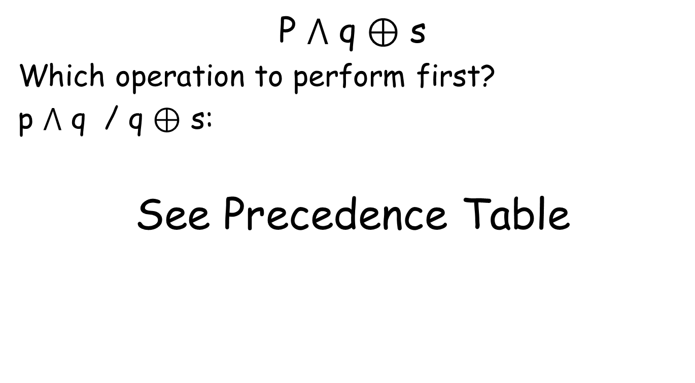
FINDING TRUTH TABLE OF COMPOUND PROPOSTIONS
P $⋀$ q $⊕$ s
Which operation to perform first?
p $⋀$ q / q $⊕$ s:
See Precedence Table

Slide 31
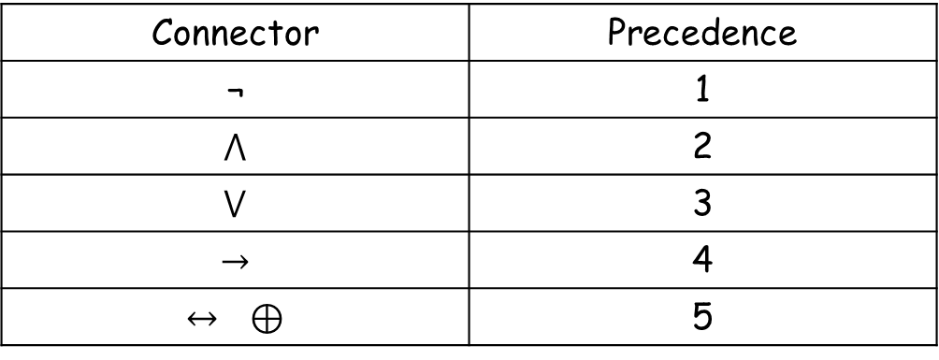
Precedence Table
Connector | Precedence
¬ | 1
$$⋀$$ | 2
$$⋁$$ | 3
$$→$$ | 4
$$↔ ⊕$$ | 5

Slide 32
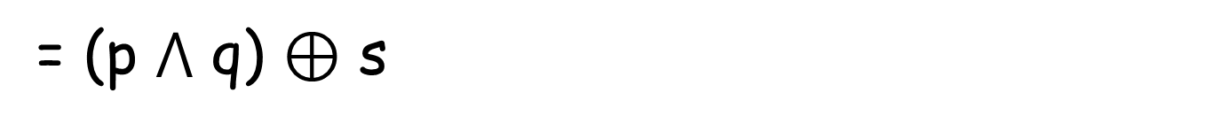

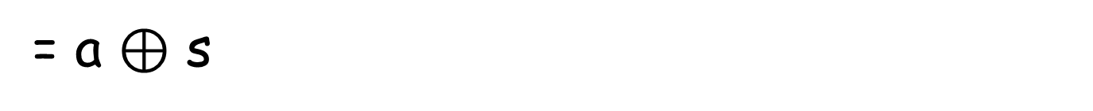
FINDING TRUTH TABLE OF COMPOUND PROPOSTIONS
P $⋀$ q $⊕$ s
= (p $⋀$ q) $⊕$ s
= a $⊕$ s
= b

Slide 33
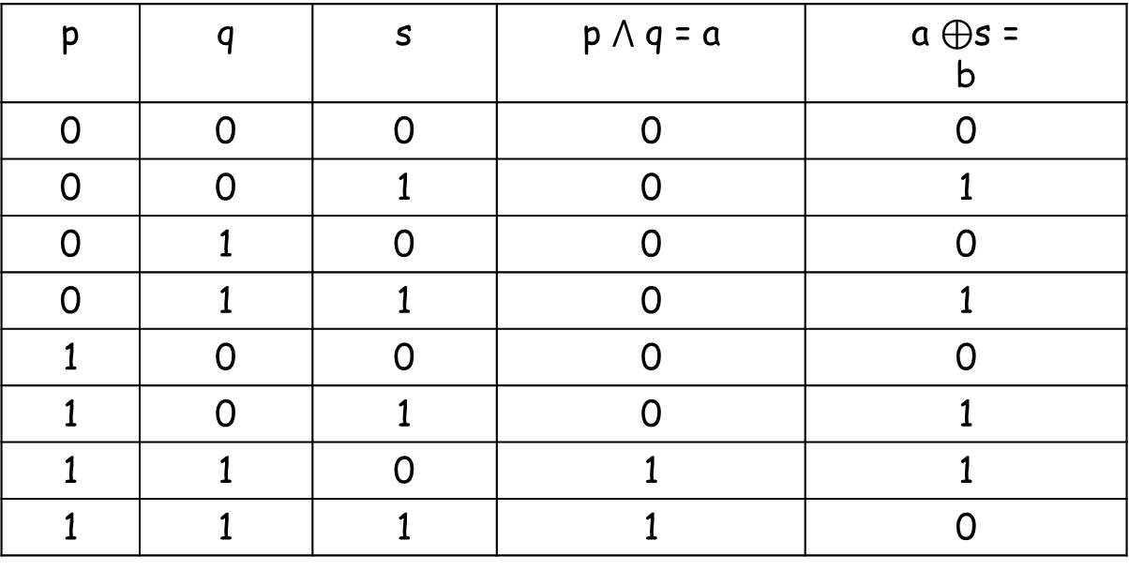

FINDING TRUTH TABLE OF COMPOUND PROPOSTIONS
P $⋀$ q $⊕$ s = (p $⋀$ q) $⊕$ s = a $⊕$ s = b
p | q | s | p $⋀$ q = a | a $⊕$s = b
0 | 0 | 0 | 0 | 0
0 | 0 | 1 | 0 | 1
0 | 1 | 0 | 0 | 0
0 | 1 | 1 | 0 | 1
1 | 0 | 0 | 0 | 0
1 | 0 | 1 | 0 | 1
1 | 1 | 0 | 1 | 1
1 | 1 | 1 | 1 | 0

Slide 34
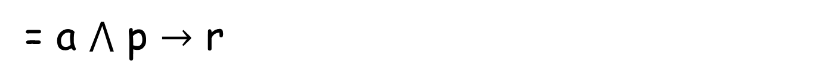
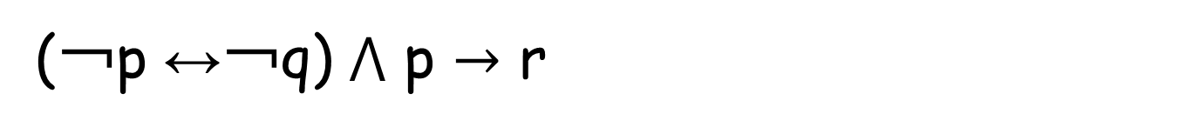
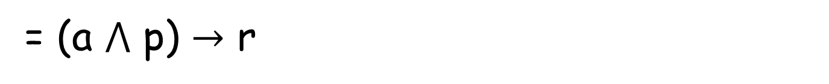
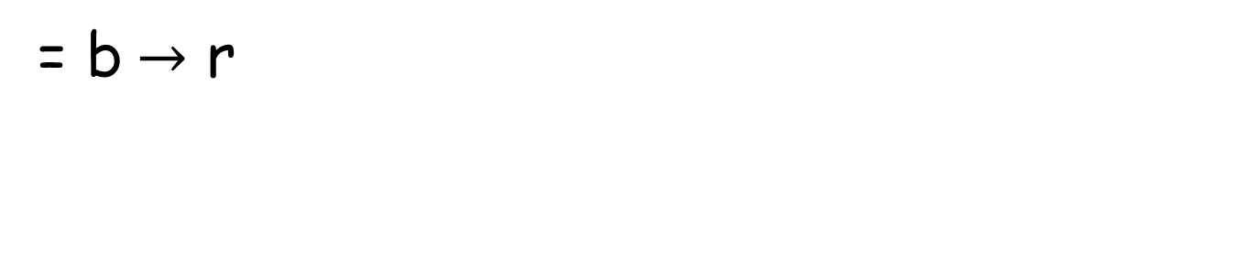
FINDING TRUTH TABLE OF COMPOUND PROPOSTIONS: Example 2
(￢p ↔￢q) $⋀$ p $→$ r
= a $⋀$ p $→$ r
= (a $⋀$ p) $→$ r
= b$→$ r

Slide 35
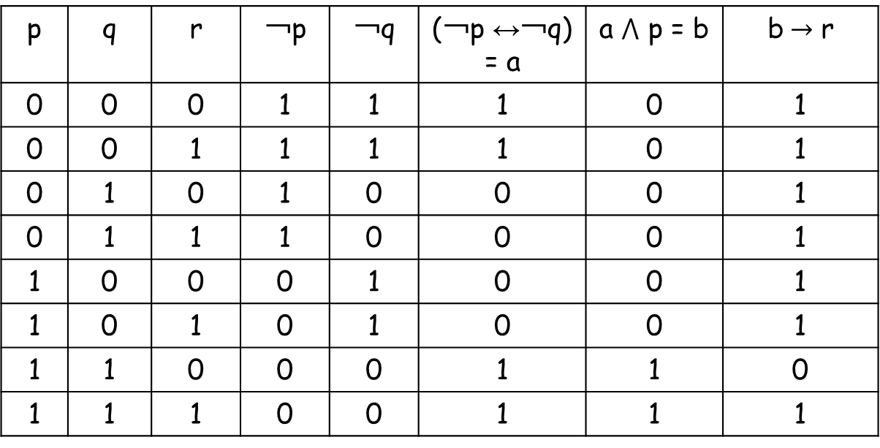
FINDING TRUTH TABLE OF COMPOUND PROPOSTIONS: Example 2
p | q | r | ￢p | ￢q | (￢p ↔￢q) = a | a $⋀$ p = b | b$→$ r
0 | 0 | 0 | 1 | 1 | 1 | 0 | 1
0 | 0 | 1 | 1 | 1 | 1 | 0 | 1
0 | 1 | 0 | 1 | 0 | 0 | 0 | 1
0 | 1 | 1 | 1 | 0 | 0 | 0 | 1
1 | 0 | 0 | 0 | 1 | 0 | 0 | 1
1 | 0 | 1 | 0 | 1 | 0 | 0 | 1
1 | 1 | 0 | 0 | 0 | 1 | 1 | 0
1 | 1 | 1 | 0 | 0 | 1 | 1 | 1

Slide 36
Propositional Equivalences

Slide 37
Tautology
[￢p ∧ (p ∨ q)] → q
p | q |  |  |  | [￢p ∧ (p ∨ q)] → q
0 | 0 |  |  |  | 1
0 | 1 |  |  |  | 1
1 | 0 |  |  |  | 1
1 | 1 |  |  |  | 1

Slide 38
Contradiction
￢([￢p ∧ (p ∨ q)] → q)
p | q |  |  |  | ￢([￢p ∧ (p ∨ q)] → q)
0 | 0 |  |  |  | 0
0 | 1 |  |  |  | 0
1 | 0 |  |  |  | 0
1 | 1 |  |  |  | 0

Slide 39
Contingency
p → q
p | q | p → q
0 | 0 | 1
0 | 1 | 1
1 | 0 | 0
1 | 1 | 1

Slide 40
Logical Equivalences
The compound propositions p and q are called logically equivalent if p ↔ q is a tautology.
Notation: ≡

Slide 41
Logical Equivalences
Compound propositions that have the same truth values in all possible cases are called logically equivalent

Slide 42
Proving Logical Equivalences: Example 1
Prove that: p ∨ (q ∧ r) ≡ (p ∨ q) ∧ (p ∨ r)

Slide 43
Proving Logical Equivalences: Example 1
Truth table of p ∨ (q ∧ r)
p | q | r | (q ∧ r) | p ∨ (q ∧ r)
0 | 0 | 0 | 0 | 0
0 | 0 | 1 | 0 | 0
0 | 1 | 0 | 0 | 0
0 | 1 | 1 | 1 | 1
1 | 0 | 0 | 0 | 1
1 | 0 | 1 | 0 | 1
1 | 1 | 0 | 0 | 1
1 | 1 | 1 | 1 | 1

Slide 44
Proving Logical Equivalences: Example 1
Truth table of (p ∨ q) ∧ (p ∨ r)
p | q | r | (p ∨ q) | (p ∨ r) | (p ∨ q) ∧ (p ∨ r)
0 | 0 | 0 | 0 | 0 | 0
0 | 0 | 1 | 0 | 1 | 0
0 | 1 | 0 | 1 | 0 | 0
0 | 1 | 1 | 1 | 1 | 1
1 | 0 | 0 | 1 | 1 | 1
1 | 0 | 1 | 1 | 1 | 1
1 | 1 | 0 | 1 | 1 | 1
1 | 1 | 1 | 1 | 1 | 1

Slide 45
Proving Logical Equivalences: Example 1
Prove that: p ∨ (q ∧ r) ≡ (p ∨ q) ∧ (p ∨ r)
p ∨ (q ∧ r) | (p ∨ q) ∧ (p ∨ r)
0 | 0
0 | 0
0 | 0
1 | 1
1 | 1
1 | 1
1 | 1
1 | 1

Slide 46
Proving Logical Equivalences: Example 2
Prove that: (p → q) ∧ (p → r) ≡ p → (q ∧ r)

Slide 47

Logical Equivalences
p → q ≡ ￢p ∨ q
p ↔ q ≡ (p → q) ∧ (q → p)
$p⊕q$ ≡ (p ∨ q) ∧ (￢p ∨ ￢ q)

Slide 48
Translating into propositional logic

Slide 49
Translating into propositional logic
if Aang is not in the path of totality during the solar eclipse, Aang won’t defeat the firelord.
a: Aang is in the path of totality
b: Aang will defeat the firelord.
￢ a → ￢ b

Slide 50
Translating into propositional logic
if you are a computer science major or you
are not a freshman, you can access the Internet from campus
a: you are a computer science major
b: you are a freshman
C: you can access the Internet from campus
a V ￢ b → c

Slide 51
Translating into propositional logic
you can access the Internet from campus
if you are a computer science major or you
are not a freshman,
a: you are a computer science major
b: you are a freshman
C: you can access the Internet from campus
a V ￢ b → c

Slide 52
Translating into propositional logic
you can access the Internet from campus
only if you are a computer science major or you
are not a freshman,
a: you are a computer science major
b: you are a freshman
C: you can access the Internet from campus
c → a V ￢ b

Slide 53
Translating into propositional logic
you can access the Internet from campus
only if you are a computer science major but you
are not a freshman,
a: you are a computer science major
b: you are a freshman
C: you can access the Internet from campus
a ∧ ￢ b → c

Slide 54
Translating into propositional logic
you can access the Internet from campus
iff you are a computer science major but you
are not a freshman,
a: you are a computer science major
b: you are a freshman
C: you can access the Internet from campus
a ∧ ￢ b ↔ c

Slide 55
Translating into propositional logic
you can access the Internet from campus
if and only if you are a computer science major but you are not a freshman,
a: you are a computer science major
b: you are a freshman
C: you can access the Internet from campus
a ∧ ￢ b ↔ c

Slide 56
Negation of propositional logic

Slide 57
De Morgan’s Las
￢(p V q) ≡ ￢ p ∧ ￢ q
￢(p ∧ q) ≡ ￢ p V ￢ q

Slide 58
Negating propositions
Find the negation of (p ∨ (￢p$⋀$ q))
￢ (p ∨ (￢p$⋀$ q))
≡ ￢ p $⋀$ ￢ (￢p$⋀$ q)
≡ ￢ p $⋀$ (￢ (￢p$) \text{∨}$ ￢ q))
≡ ￢ p $⋀$ (p$\text{∨}$ ￢ q)

Slide 59
Negating propositions
Find the negation of p ↔ q
￢ (p ↔ q)
≡ ￢ (p → q ∧ (q → p))

